Slide 1
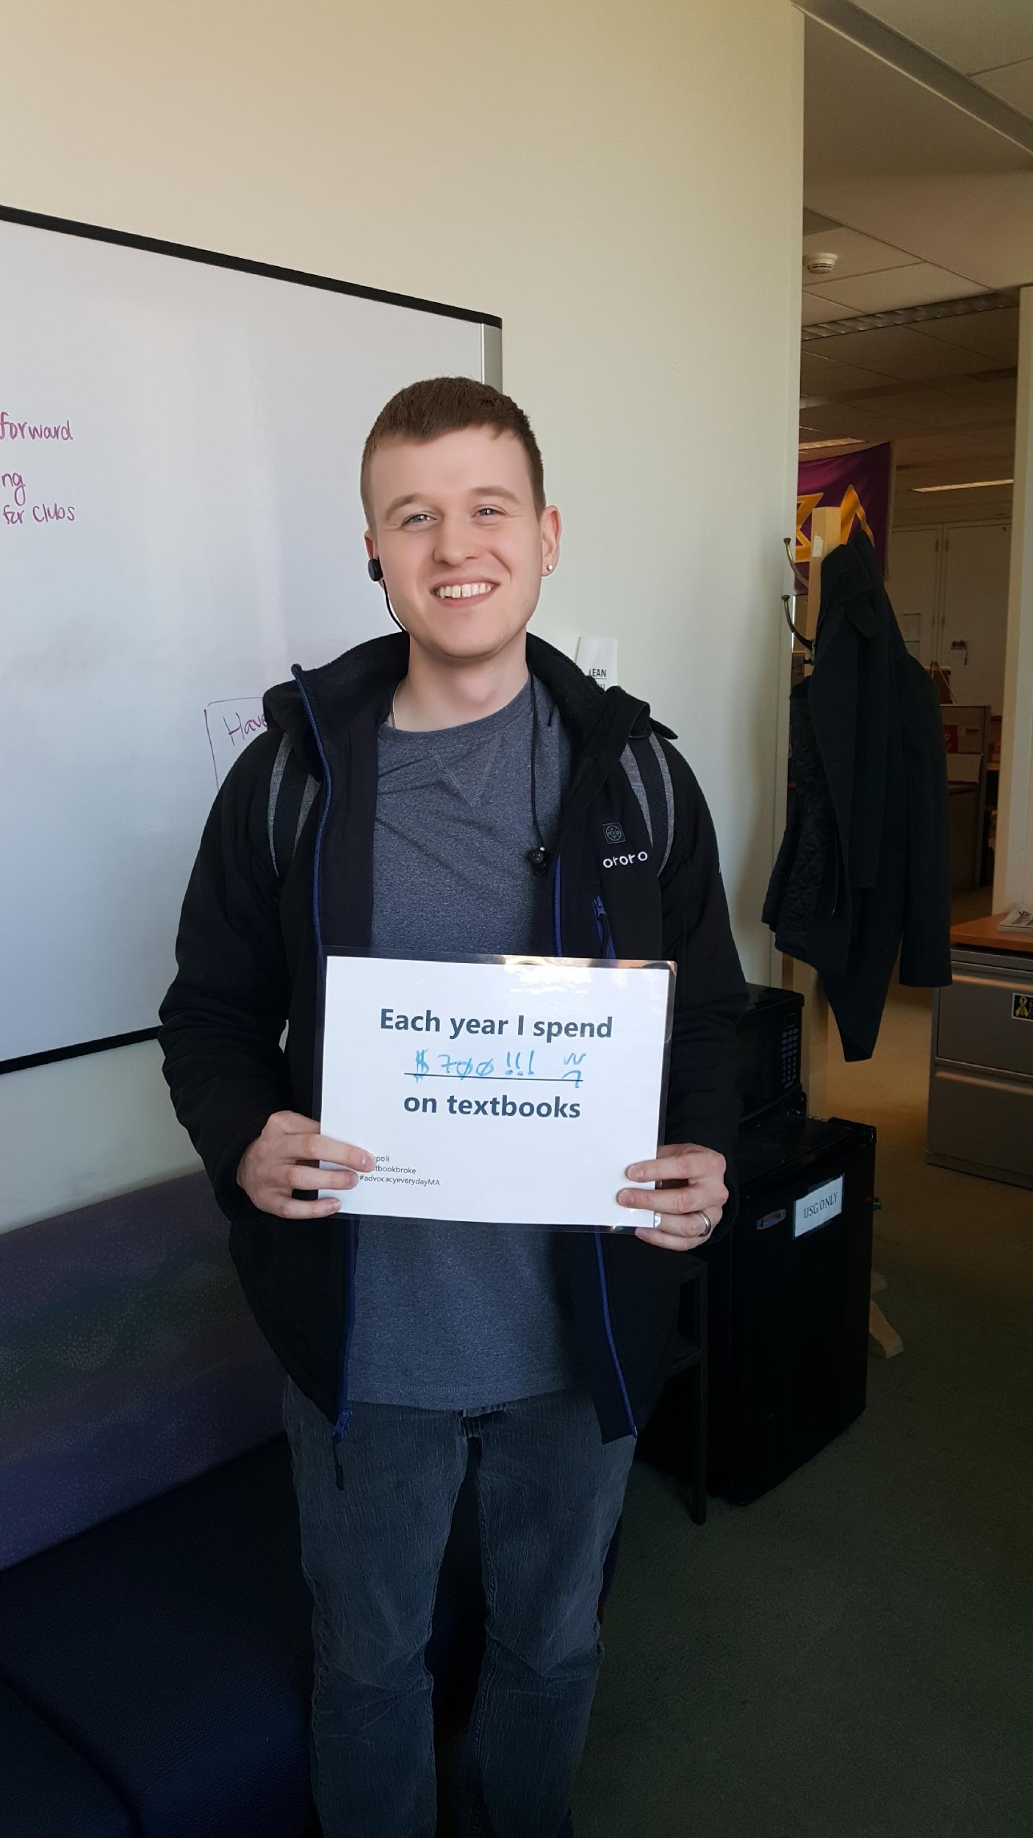
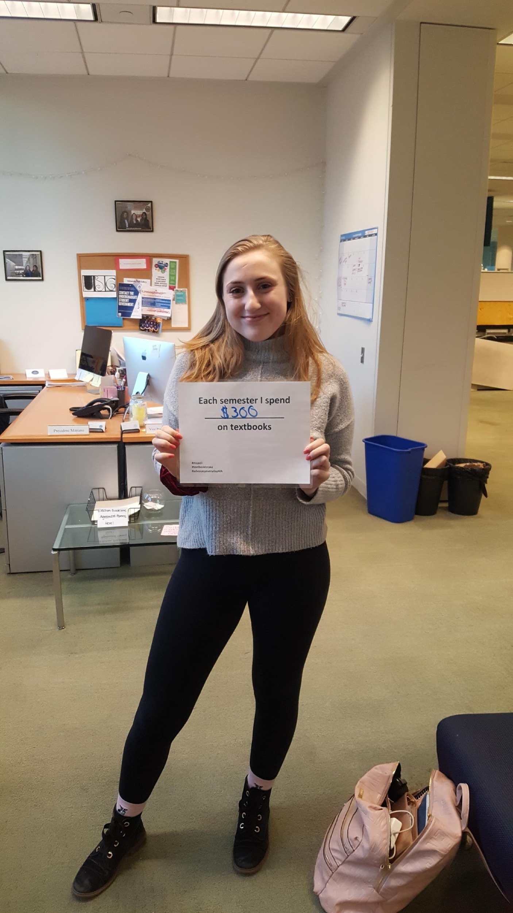
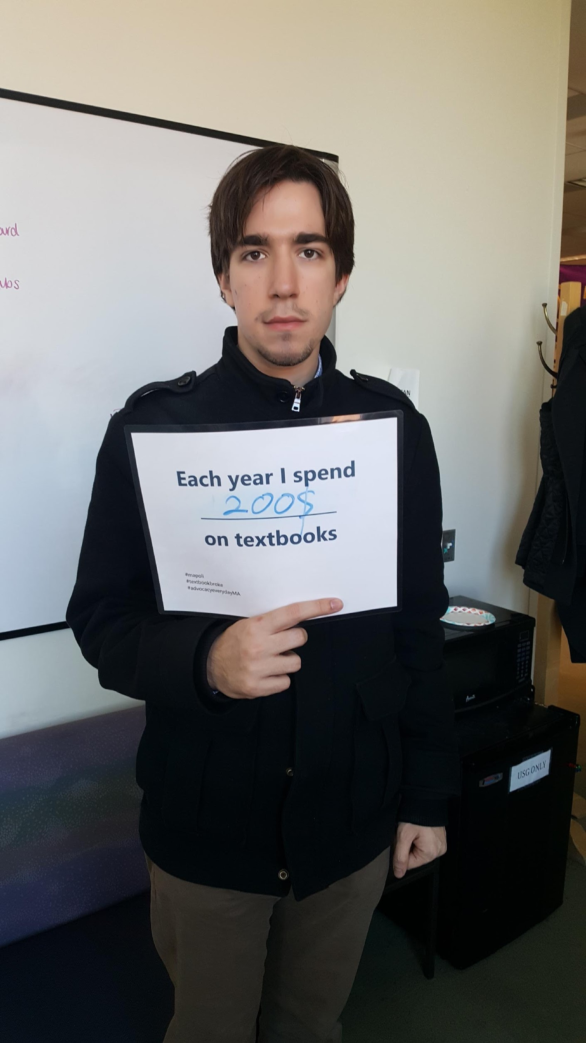
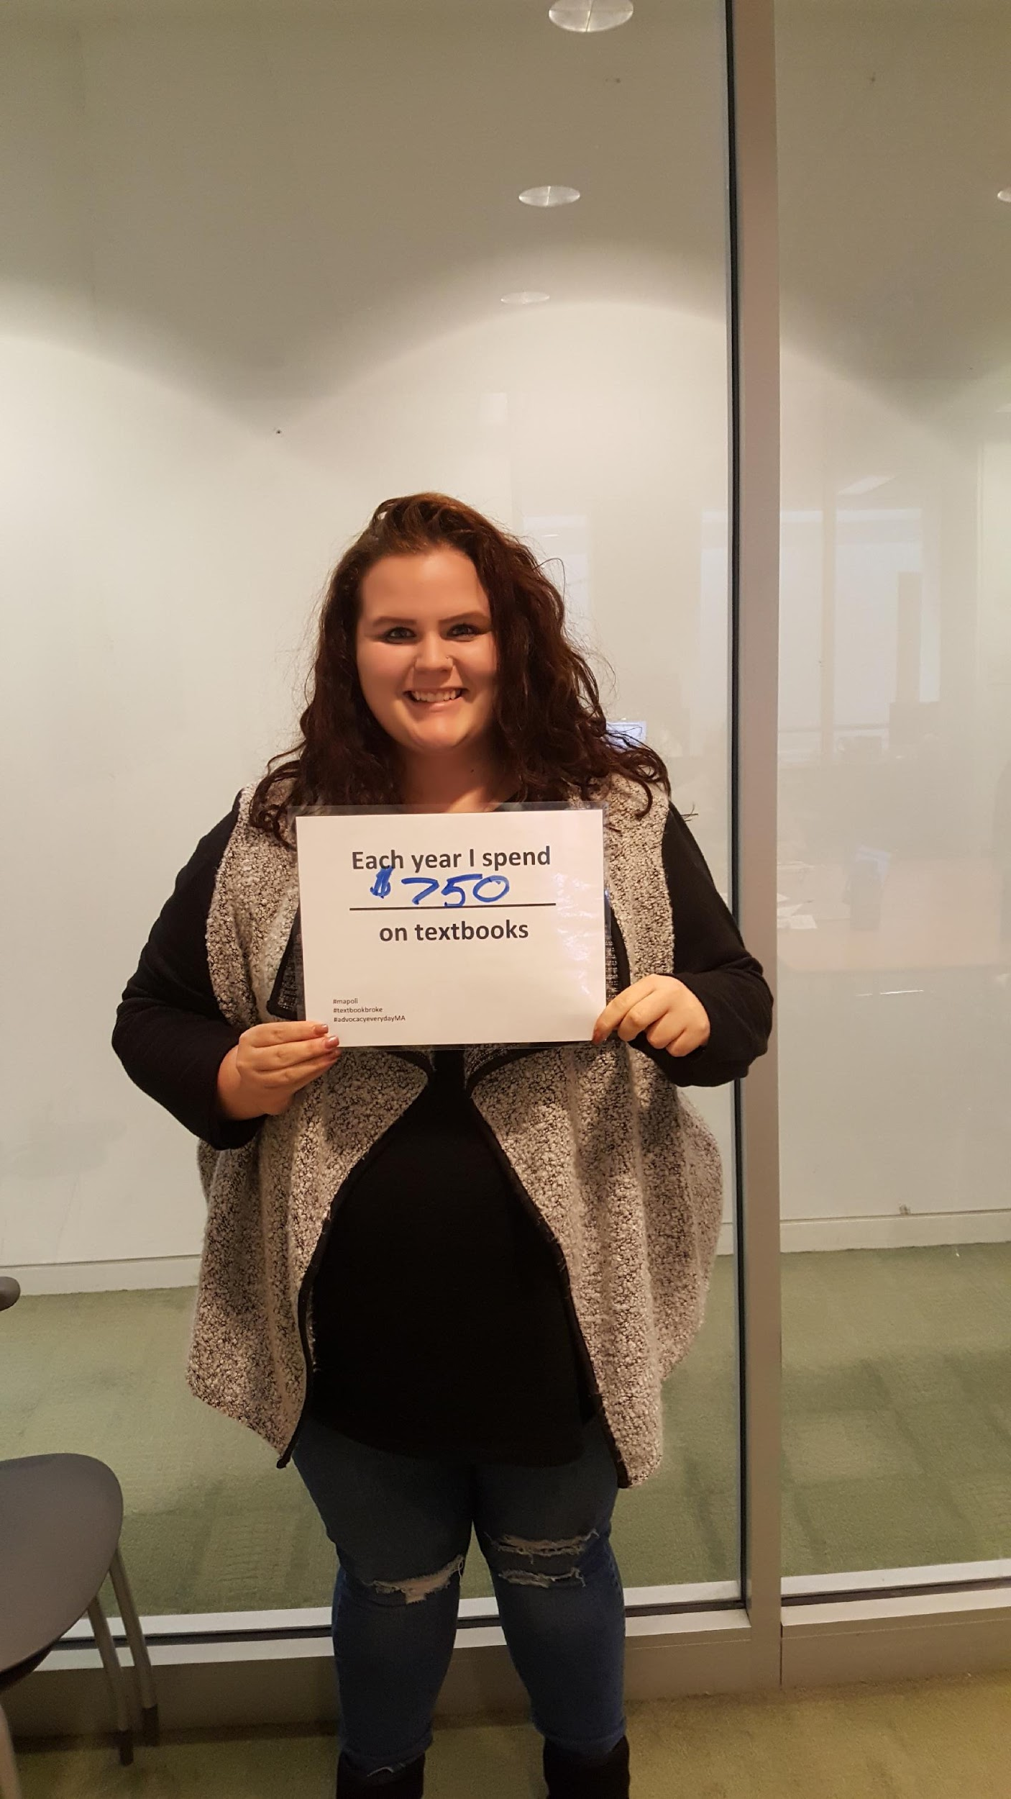
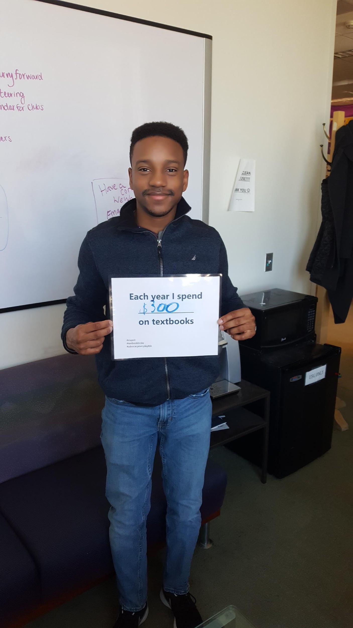
Impact of Cost of Textbooks on Students
By USG and MASSPIRG

Slide 2
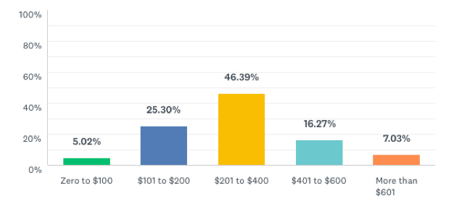
How much do you typically spend per semester on textbooks and course materials?
National average = $600 per semester
only 7% say they are spending more than the national average…
…but 63% say they are spending more than $201 and that may be too much for our students
Notes:
First, let’s start off with how much students are spending nationally on textbooks. Nationally students are spending an avg of $600 a semester on materials. 63% of students are spending more than $200 and many students at UMB work while in school so this may be more than our students can afford. 2 in 5 UMB students are food insecure so if they can’t afford food they definitely can’t afford to spend $300 on textbooks.

Slide 3
How much do you think the average UMB Student was recommended to budget for textbooks during the 2020-21 academic year?

Slide 4
The average student at UMB should budget
$800-1,000*
for textbooks and course materials in 2020-21.
Notes:
According to the the U.S. Department of Education's 2020 IPEDS survey response for University of Massachusetts Boston students should budget $800 annually for textbooks or $400 per semester. So while it’s not as high as the national average it’s still a large expense for students. This also is just one factor of the cost of attendance, tuition and cost of living can be a strain but as professors material cost is how you can help.

Slide 5
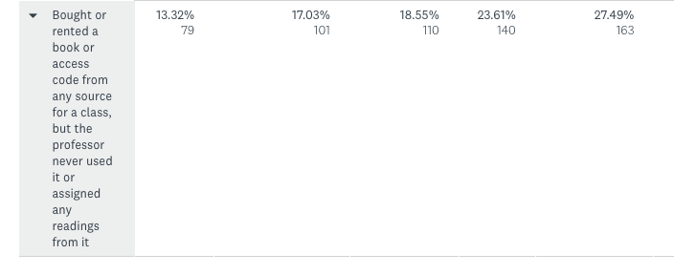
How often have you…bought/rented a book… for a class but the professor never used it or assigned readings from it?
Never Once or Twice Sometimes Often Frequently
27% of students said that they frequently bought books that were never used in class
Notes:
After students spend hundreds of dollars on textbooks, 27% reported they never used books they bought for classes essentially wasting money

Slide 6
Student Comments
“Books are way more expensive than they need to be. As a college student, it is made very difficult to further our education at such a price.”
“Affording textbooks is super stressful as a student making minimum wage who is also trying to pay for tuition and daily life expenses (gas, food, car insurance/payments, rent, etc).”
“I've spent over $5,000 in books within my years here and half the time the books weren't needed and if I ever resold it was for about 10-15% of the original cost. Thank you for doing this.”

Slide 7
Student Comments
“Professors should use open source textbooks or old (books) to relieve the financial stress of college.”
“I loved the Openstax site for free textbooks. More professors should use it.”
“Books are crazy expensive-but I definitely need them to do well in my courses.”
“Most professors use the books they require as secondary material, and usually do not use, or require the use of the book throughout the semester.”

Slide 8
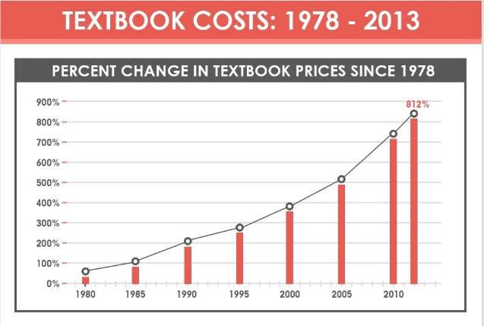
https://www.aeseducation.com/blog/infographic-the-skyrocketing-cost-of-textbooks-for-schools-students
Notes:
textbook costs have increased at 3x the rate of inflation (88% over the last decade) especially for intro and stem courses

Slide 9
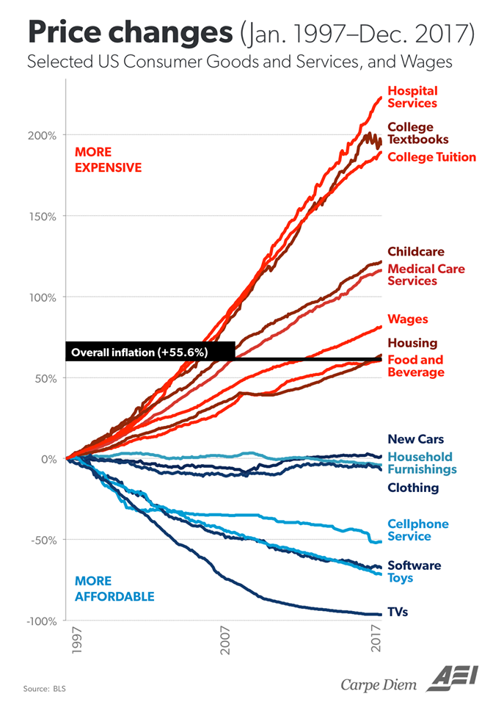
Notes:
The cost of textbooks shouldn’t be that high. they’ve risen higher than inflation, and the cost of other similar or more expensive items.

Slide 10
In your academic career, has the cost of required textbooks caused you to:
2012 | 2016
63.6% | 66.5% | Not purchase the required textbook
49.2% | 47.6% | Take fewer courses
45.1% | 45.5% | Not register for a specific course
33.9% | 37.6% | Earn a poor grade
26.7% | 26.1% | Drop a course
17.0% | 19.8% | Fail a course
http://www.openaccesstextbooks.org/pdf/2012_Florida_Student_Textbook_Survey.pdf
Notes:
These are a look at the impact required texts have had on students in 2012 vs 2016. In Fall 2020, 65% of students skipped buying a textbook due to cost, even though 90% reported that they worried it would negatively impact their grade. Without access to books, many students struggle to succeed in their classes. Nearly half of all students say that the cost of course materials impacts which classes and how many classes they are able to take.

Slide 11
Coping with the Cost
Purchase an older edition of the textbook
Delay purchasing the textbook
Never purchase the textbook
Share the textbook with other students
(Illegally) download textbooks from the internet
Notes:
Students have come up with ways to try to cope with the rise of the cost of textbooks. This includes purchasing an oldr edition of the required book, delaying or never buying the book, sharing materials with classmates, and illegally downloading books.

Slide 12
Textbook Publishers
Access Codes
Puts homework behind a paywall
Can’t keep the textbook after the semester
New Editions
Not much changes from most editions except some formatting and graphics
Notes:
Textbooks publishers come up with ways to keep making money and force students to buy their textbooks. The most common ways of doing this are through access codes which may seem convenient to have all your homework, quizzes, and textbooks in one place but it actually pust students homework behind a paywall so if they can’t afford to spend $200 on one class’s access code they will academically perform poorly. It also doesn’t allow students to keep the book to reference later or sell. This limits one way students have found to fight the cost of textbooks which is through selling their books after they’re done with them. Access codes are specifically designed to prevent students from doing this and forcing them to pay full price from publishers. Another way publishers keep students buying textbooks from them is releasing new editions. In reality most new editions don’t change much in content but will update a few graphics and examples and then charge students more for it. Just five publishers control 80% of the textbook market, so they rarely compete directly on price.

Slide 13
What can we do?
Tuition and Fees
Room and Board
Books and Supplies
Personal Expenses
Transportation
Notes:
Textbooks is not the highest cost leading to these affordability issues – but it is:
the one cost that you as faculty can impact
it has a special impact on the academic success of students (as we’ll see later)

Slide 14
Poll: Are you familiar with the term “open education resources” or “open textbooks”?

Slide 15
The Solution…
Notes:
So what’s the solution to all of these problems?

Slide 16
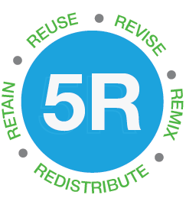
What are open textbooks?
Open Educational Resources (OER) are teaching, learning and research materials in any medium – digital or otherwise – that reside in the public domain or have been released under an open license that permits no-cost access, use, adaptation, and redistribution by others with no or limited restrictions.
https://www.hewlett.org/strategy/open-educational-resources/
Notes:
Open Educational Resources (OER) are teaching, learning and research materials in any medium – digital or otherwise – that reside in the public domain or have been released under an open license that permits no-cost access, use, adaptation, and redistribution by others with no or limited restrictions. Essentially they are free or low cost for students to use.

Slide 17




Where can I find open textbooks?
Notes:
Here are some resources and for UMB this is a place to look: https://www.umb.edu/elearning/open_education/find_oer

Slide 18
OER Impact on Students
Data from Tidewater Community College’s textbook-free degree program shows notable increases in student completion and performance when faculty members become more engaged with the classroom materials.
A journal-published analysis of over 16,000 students at public institutions showed that students using open materials perform as well, if not better, than their peers using traditional course materials.
Notes:
Students not only save money with open textbooks but they perform better academically. You’re all here because you want to teach students and give them what they need to do their best. Students that use materials with little to no financial strain will perform better.

Slide 19
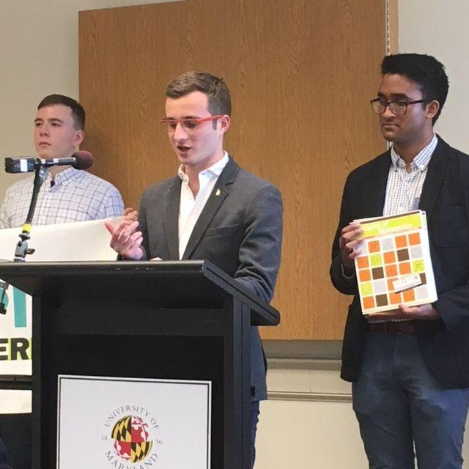

Active OER Programs & Campaigns
Mature OER grant programs
UConn Storrs
UMass Amherst
Rutgers University
University of Maryland
University of Washington
Rhode Island
Limited OER programs
UNC Chapel Hill
NC State
UNC Greensboro
Holyoke Comm College
University of Oregon
Lane Comm College
Southern Oregon University
UCLA
Notes:
Rutgers saved students $1.5 million by focusing on introductory texts
UMass Amherst has saved students over $1 million in its first four years
RI Office of Innovation, in partnership with Rhode Island College and all ten other higher education institutions in RI, launched a statewide Open Textbook Initiative to save students $5 million over five years.
Open Oregon Educational Resources is a joint project of the state’s 17 community colleges
These are just a few- here is a more expansive list: https://sparcopen.org/our-work/list-of-oer-policies-projects/

Slide 20
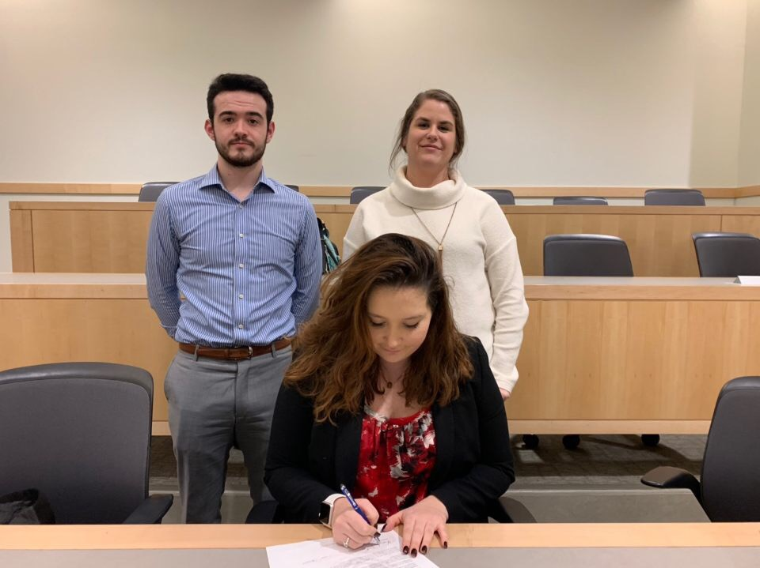
What’s Already Happening on Campus
In 2019, Student Government passed a resolution supporting more widespread adoption of OER
Some faculty use open textbooks or low cost materials
MASSPIRG has been collecting faculty sign ons in support

Slide 21
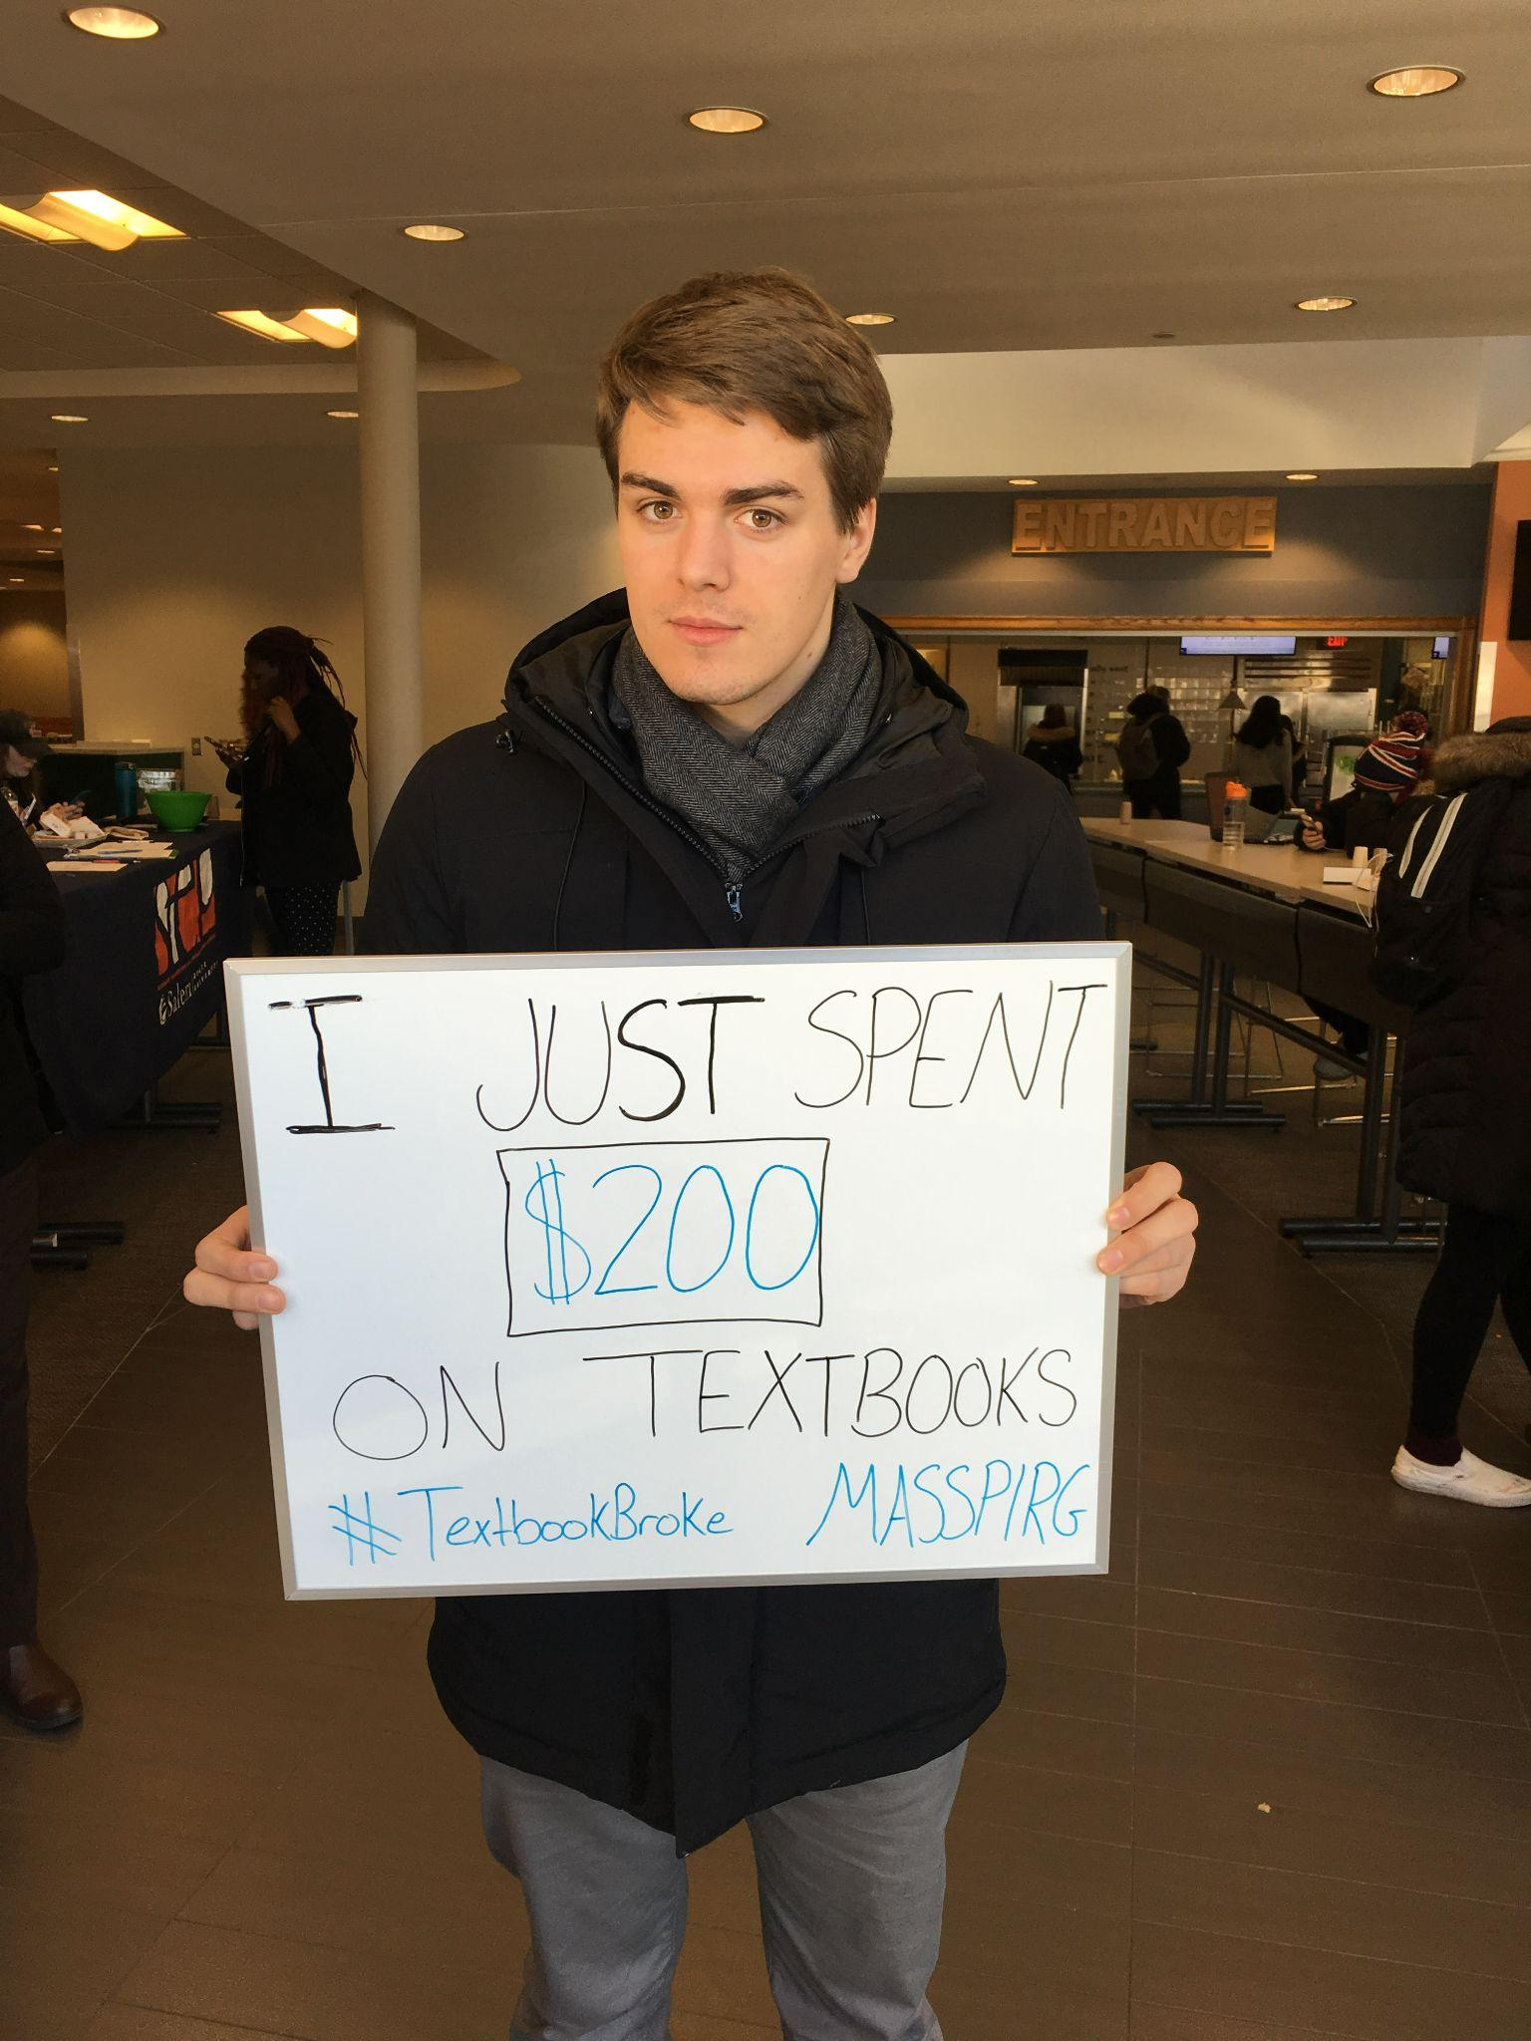
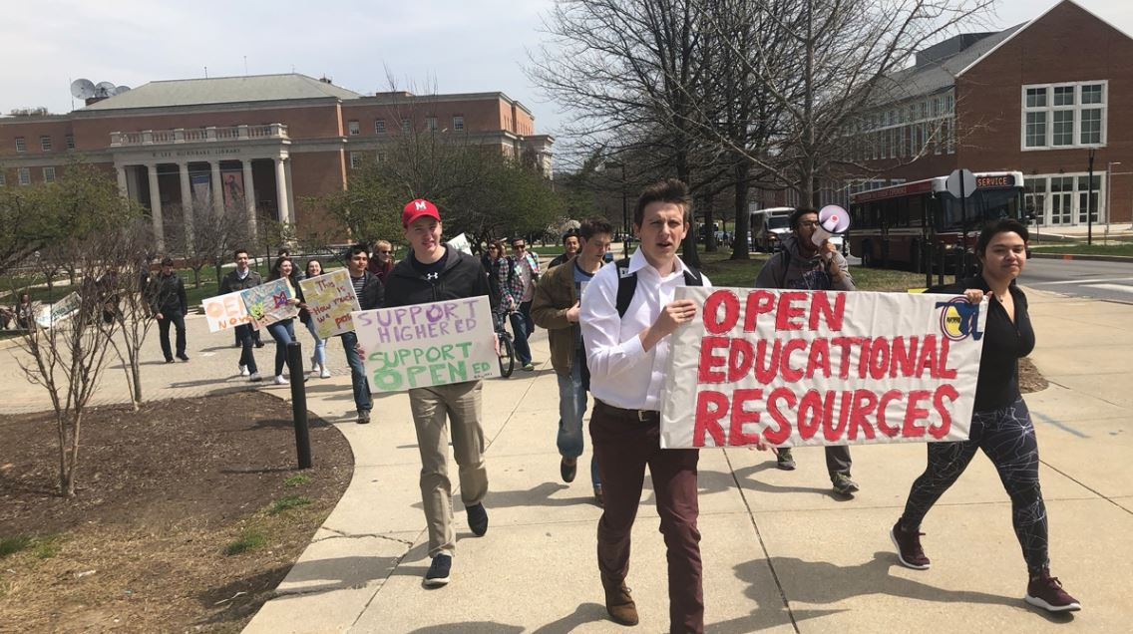
Textbook Price Transparency
Notes:
The OER coalition at UMB is working on 2 initiatives. 1) We want to implement course marking which means when a student is registering for classes they can see what classes are using free or low cost materials. This helps students budget for the upcoming semester better and prevents them from enrolling in a course and dropping it in the first week due to material cost. Schools across the country are already doing this here in MA, Middlesex Community College does this. 2) We also want to create an incentive program to compensate faculty for their time and effort from switching from traditional textbooks to open textbooks. We are currently working on a budget for the first semester of the program.

Slide 22
Poll: Would you consider adopting an open textbook/resource for your course?

Slide 23
Questions?
Thank you for attending!
Notes:
Contact: Lucas Hall (Library) Lucas.Hall@umb.edu

