Slide 1


Slide 2
Open Educational Resources
What we aim to cover today
What are OER
Benefits of OER
Our goal/charge
The Task Force
Plans for the coming months with a ‘Go Live’ date of Fall 2022
OER Resources

Slide 3
Open Education Resources - Definition
“OER are teaching, learning, and research resources that reside in the public domain or have been released under an intellectual property license that permits their free use and re-purposing by others. Open educational resources include full courses, course materials, modules, textbooks, streaming videos, tests, software, and any other tools, materials, or techniques used to support access to knowledge.”
The William and Flora Hewlett Foundation

Slide 4
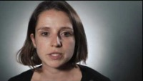
Open Education Resources - what are OER
O → Open – Openly Accessible / public domain
E → Educational – Teaching, Learning, and Research resources
R → Resources – Content to support access to knowledge.
Think Five R’s
  Reuse - use freely for own purpose
  Redistribute - share with others
  Revise - adapt, modify, change
  Remix - combine / transform
  Retain: download and save
What are OER - A 90 second video by Lumen Learning

Slide 5
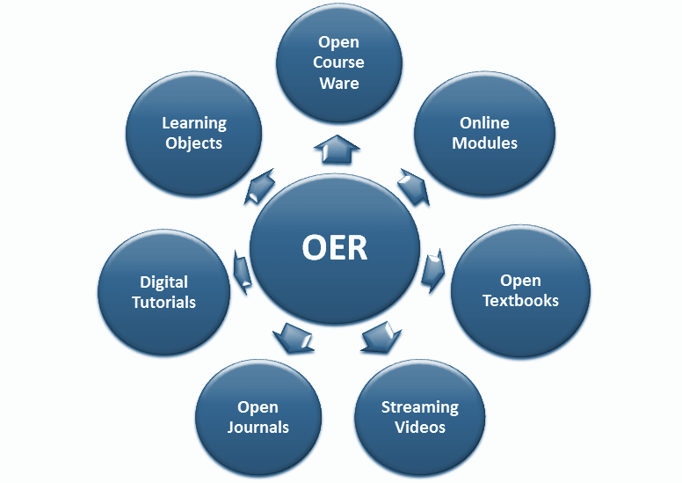
Open Education Resources – Types of OER’s

Slide 6
Open Education Resources – Benefits & Challenges
Benefits
Reduce Cost of Education / textbook costs
Support student success & retention
Equal Access – All students have access to the textbook on day 1
Accessibility – as it is born digital
A platform for faculty to create/edit/revise OER
Challenges
Quality – OER repositories include peer review and rating systems
Time – adopting OER will take time
Lack of ancillary content – however this is changing

Slide 7
Open Education Resources – Our Goal
To build a program that promotes textbook affordability for students by supporting and facilitating the adoption of open, low-cost, high-quality materials, called Open Educational Resources, or OER.

Slide 8
Open Education Resources – Team
Bringing together Faculty, Students, MASSPIRG, Library & IT with support from the Provost office.
Names | Names
Prof. Serra Acar (CEHD) | Ellen Foust – IT/eLearning & Instructional Design
Prof. Steve Ackerman (Honors) | Danny Rojas – Research Fellow (Provost’s Office)
Prof. Xiaolu Xu (CM) | Kush Patel – Chancellor’s Office
Joshua (Jake) Bates – USG | Open Position – Graduate Student
Lucas Hall – Library | Andrew Perumal – Associate Provost
Brianna Blastick – MASSPIRG | Apurva Mehta – IT
AlexieLudgie Goin – MASSPIRG

Slide 9
Open Education Resources – How Do We Get There?
Course Syllabi
Project Activity | Status
Develop the Baseline – against which we can evaluate progress | Ongoing
- Review course syllabi, library reserves, survey faculty
Increase Awareness among faculty on the benefits of adopting OER | Planning
- Host Events - example: March 7 – 11th is OER Week
Offer professional development opportunities to our faculty on adopting/using and developing OER content. | March/April
Work with the registrar office to flag courses in WISER that use OER /Low-Cost material | Ongoing
Request funding for incentive program | March/April
Build the Incentive program | April
Call for proposals from faculty, review proposals, announce winners, etc. | April
Implement program - Librarians and Instructional Designers work with Faculty | May/June
Recognize faculty for adopting OER, document cost savings, update OER Website | December

Slide 10
Open Education Resources – Resources
Find OER - https://www.umb.edu/elearning/open_education/find_oer
Library Databases/Resources & LinkedIn Learning
State of Massachusetts OER Initiative
Metafinder @ George Mason
OER Commons
Merlot
OpenStax
OTN (Open Textbook Network) – Univ. of Minnesota
Lumen Learning – Low-cost open courseware -$25 per student

Slide 11
Open Education Resources – Questions
Visit: OPEN.UMB.EDU → OER Adoption Program
Email: open@umb.edu
The team is happy to help and look forward to working with you!

