Slide 1
Overview of Chartfield Strings
OFFICE OF THE CONTROLLER, UNIVERSITY OF MASSACHUSETTS BOSTON

Slide 2
Chart of Accounts
Chart of Accounts: Chartfield Strings
What is a chart of accounts?
System of organizing and identifying revenue and expense
Provides a structure for financial reporting
external (financial statements)
internal (departments)
Supports internal controls (who can approve transactions)
Maintained by central finance areas
(Controller’s Office, Office of Budget & Financial
Planning, Office of Research & Sponsored Programs)

Slide 3
Chart of Accounts: Chartfield Strings
Within the chart of accounts, each pool of university resources is identified by several pieces of information. The individual pieces, or fields, are called chartfields. A set of chartfields are collectively referred to as chartfield strings.
Chartfield strings are used to:
complete Personnel Action (PA) forms
submit travel reimbursement requests
complete purchases in BuyWays
reallocate ProCard expenditures
look up account balances
organize information in financial reports

Slide 4
Chart of Accounts: Chartfield Strings
The individual pieces, or chartfields, include the following:
Business unit
Identifies data belonging to the campus within the UMass system
Fund
Identifies a pool of resources based on its source of revenue
Department
Identifies delegation of authority to a particular area
Program Code
Utilized for external financial reports, which identifies how resources are being used (e.g. for instruction, research, etc.)
Project / Grant
Identifies sponsored or non-sponsored projects
Account Code
Identifies the type of commodity or service purchased
A speedtype is a shortcut for a department / fund combination.
A subsidiary is a grouping of account codes.

Slide 5
Chart of Accounts: Chartfield String Example
1st 5 characters: Department
2nd – last character:
Further detail (e.g., Office & Administrative Supplies)
Last 3 characters:
Identifies campus
2nd – last character:
Further detail
Not used at UMB
1st 2 characters:
Identifies system
1st character: Identifies campus
2 characters: Sub-department
3 characters : Cost center
Business Unit | Fund | Department | Program Code | Project / Grant | Class | Account Code
UMBOS | 53106 | B008300000 | B00 | S20120000019939 |  | 734200
1st character:
1 = State Funds
5 = Trust Funds
Last 3 characters:
Further detail
1st character:
A = Financial Aid
B = General Operating Fund Projects
E = State Specials
F = Facility Projects
P = Other Campus Projects
R = Restricted Gifts
S = Sponsored Agreements
1st character:
1 = Asset
2 = Liability
3 = Fund balance
4 = Fund addition
5 = Fund deduction
6 = Revenue
7 = Expenditure
2nd character:
1, 2 = Unrestricted
3 = Restricted
5 = Loan
7 = Plant
9 = Agency

Slide 6
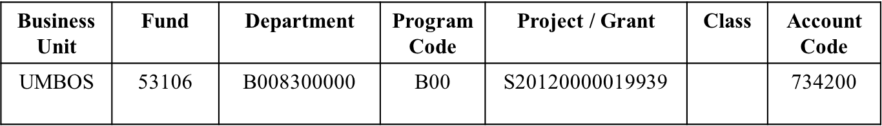
Chart of Accounts: Fund
Following is sample of Funds and Descriptions:
Fund 11000 51005 51006 51121 51161 51438 52129 53106 … | Fund Description State – Main Allotment In-State Tuition Out-of-State Tuition Educational Sales & Services (ESS) General Operating Fund (GOF) Development RTF-Boston Federal Grants & Contracts … | Source State funding Tuition & Fees Tuition & Fees Incidental sales & services (tickets, etc.) Student mandatory fees Gifts F&A indirect Federal Government …

Slide 7
Chart of Accounts: Department
Top-level Department
Biology
B008300000
Sub-department
Biology - Laboratory
B008303000
Cost Center
Biology DNA Sequencer
B008300001

Slide 8
Chart of Accounts: Program Code
Program codes are important for financial reporting which include the following categories:
Program Code | Category
A00 | Instruction
B00 | Research
C00 | Public service
D00 | Academic support
E00 | Student services
F00 | Institutional Support
G00 | Plant Operations & Maintenance
H00 | Scholarships
L00 | Auxiliary Enterprises

Slide 9
Chart of Accounts: Account Code
Subsidiaries are a secondary level of detail, grouping like-account codes.
The following is a list all subsidiaries and corresponding account codes:
Subsidiary | Account Code | Description
AA | 700821 | Employee compensation
BB | 700802 | Employee-related (reimbursements)
CC | 700803 | Special employee payroll
DD | 700804 | Fringe benefits
EE | 700805 | Administrative
FF | 700806 | Facility operational
GG | 700807 | Energy & Space rental
HH | 700808 | Consultant services
JJ | 700810 | Operational services
KK | 700812 | Equipment purchases
LL | 700813 | Equipment Lease & Maintenance
MM | 700814 | Purchased Client Services
NN | 700815 | Infrastructure & land
RR | 700817 | Entitlement programs
UU | 700844 | Information technology

Slide 10
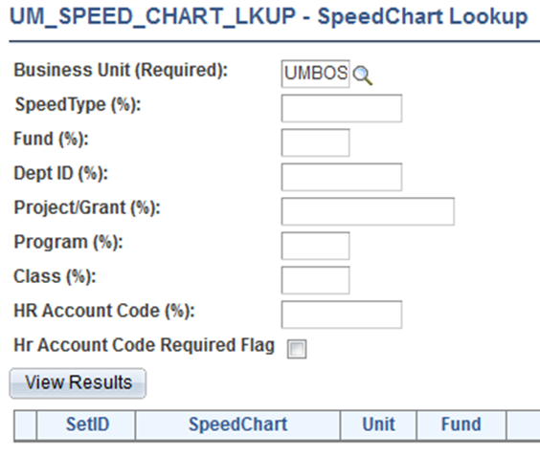
Chart of Accounts: How to Lookup Chartfield Information
Go to: https://www.umassp.edu/connect
Locate category “Operational/Project Tools”, and select “Chartfield Lookup”
Enter UMBOS in the “Business Unit” field
Enter specific fund, department, speedtype, or other chartfield for additional information
Click “View Results”

