Slide 1

University of Massachusetts Boston Summary: -FY24-28 Capital Plan

Slide 2
FY24-28 UMB 5-Year Capital Plan - $192.5M
DCAMM $24.1M
UMBA (UMASS commercial paper, SDQD Project) $31.2M
Total SDQD Project Cost $183M for reference (SDQD $138.8M, REAB $44.2M) including spend from prior years
Vendor contracts $1.9M
Federally funded $3.7M
Local Funding Sources $131.6M
Local Funding Sources FY24 (Local Cash) $41.8M
$5.9M from reserves in revenue-based operations (lab fees, gifts, ESS, RTF, etc.)
$35.9M from reserves generated by depreciation & general cash reserve
$9.2M Campus cash from DCAMM split projects
$11.9M Compliance
$3.0M FY23 Approved projects already underway
$6.1M FY23 Approved not started
$5.8M New projects
Local Funding Sources FY25-28 (Local Cash) $89.9M
1.2M from reserves in revenue-based operations
$88.7M from reserves generated by depreciation
$30.6M Campus cash from DCAMM split projects
$10.2M Compliance
$12.5M Approved projects already underway
$12.2M FY23 Approved not started
$23.2M New projects

Slide 3
FY24-28 UMB 5-Year Capital Plan - $192.5M
Relationship to Strategic & Master Plans:
The last major component of the 2009 Boston Campus Master Plan, the SDQD project, is nearing completion.
Boston has completed a new Campus Master Plan to set the course for the next decade plus.
New capital projects are focusing on critical deferred maintenance and compliance/safety related issues, with a particular emphasis on Title IX compliance enhancing initiatives in Athletics.
Federal funds have been secured to complete a programmatic study and construct a Home Care Digital and Simulation Lab for the Manning College of Nursing and Health Sciences.
Focus on Deferred Maintenance:
Boston’s current capital projects are focusing on identified deferred maintenance in some of our older facilities.
Projects are focusing on facades, primary transformers, building entrances, HVAC, fire alarms and building controls upgrades.
Commitment to Sustainability:
Boston continues its focus on sustainability and resiliency and has completed a Campus Energy Carbon Master Plan to guide the Campus toward net zero by 2050 and to meet the interim milestone goals set by the State.
A major overhaul and expansion of capacity of the Campus’ Salt Water Pump House and harbor cove dredging project has been launched to utilize clean, green sources of cooling and potentially heating.
In addition to over 1mw of solar capacity, the Campus has added 500kw of battery storage that can be fed back into the electrical distribution.

Slide 4
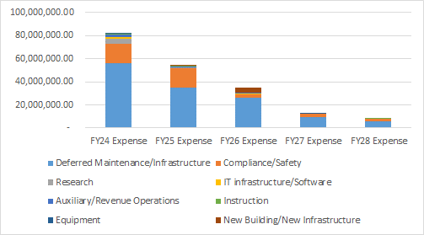
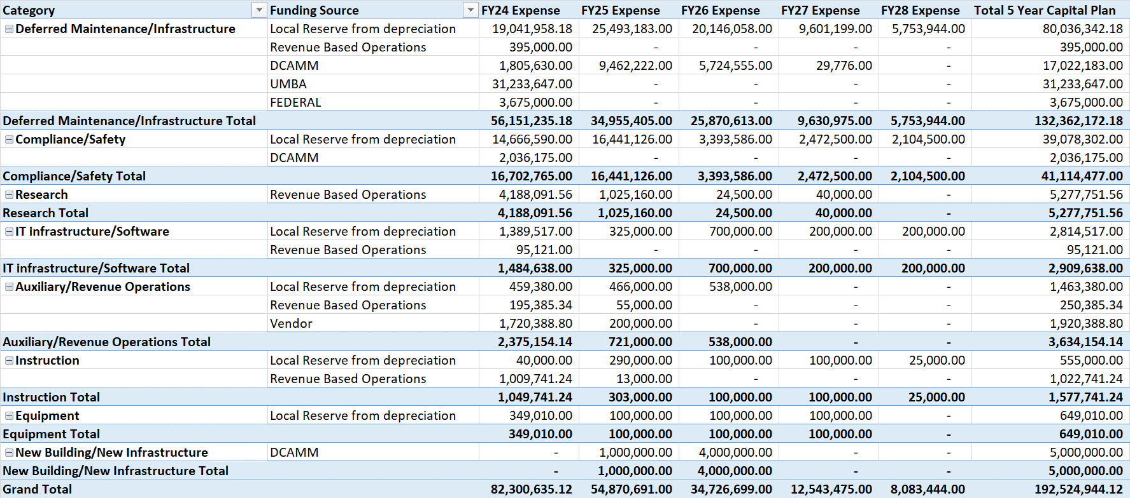
FY24-28 UMB 5-Year Capital Plan - $192.5M (by project category)

Slide 5
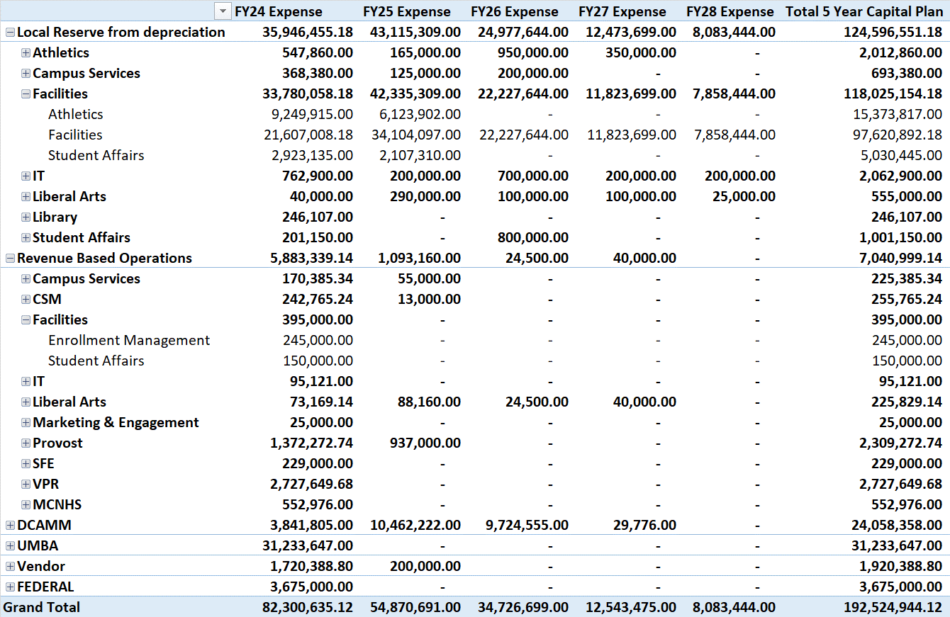
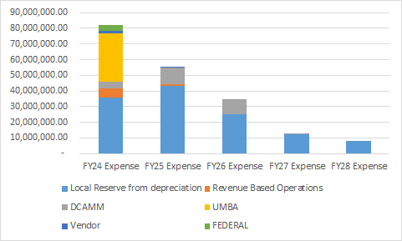
FY24-28 UMB 5-Year Capital Plan - $192.5M (by funding source)

Slide 6
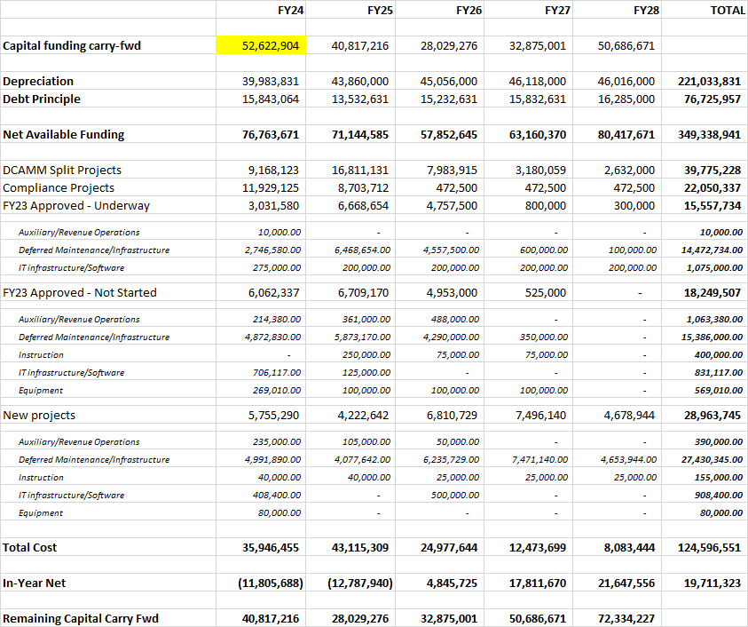
FY24-28 Local Funding from depreciation reserve

Slide 7
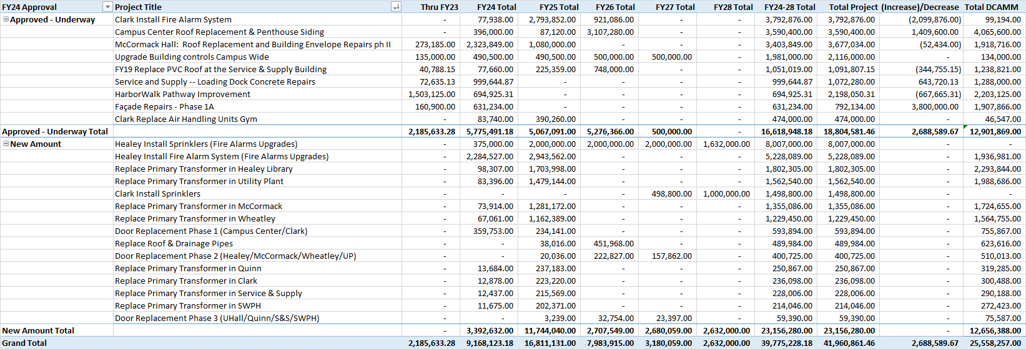
FY24-28 DCAMM split local funding

Slide 8
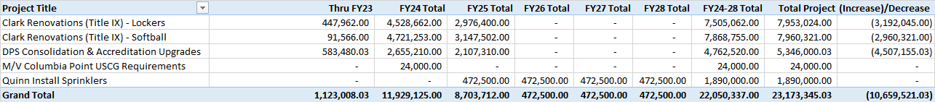
FY24-28 Compliance/Safety local funding

Slide 9
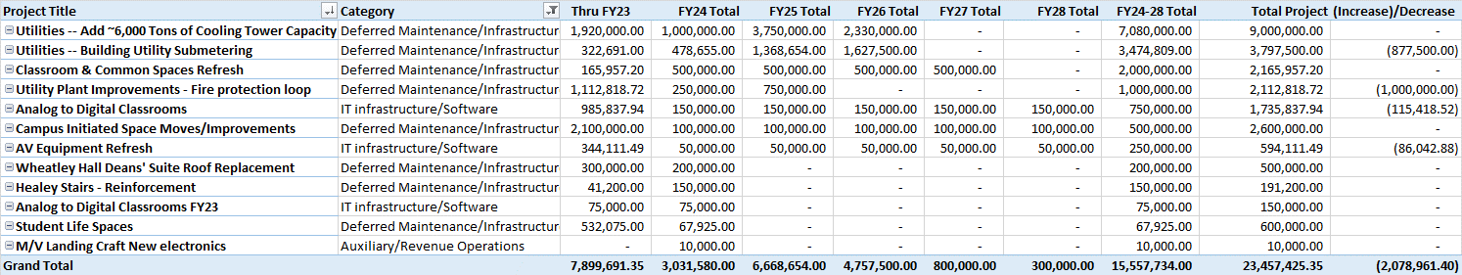
FY24-28 Approved underway local funding

Slide 10
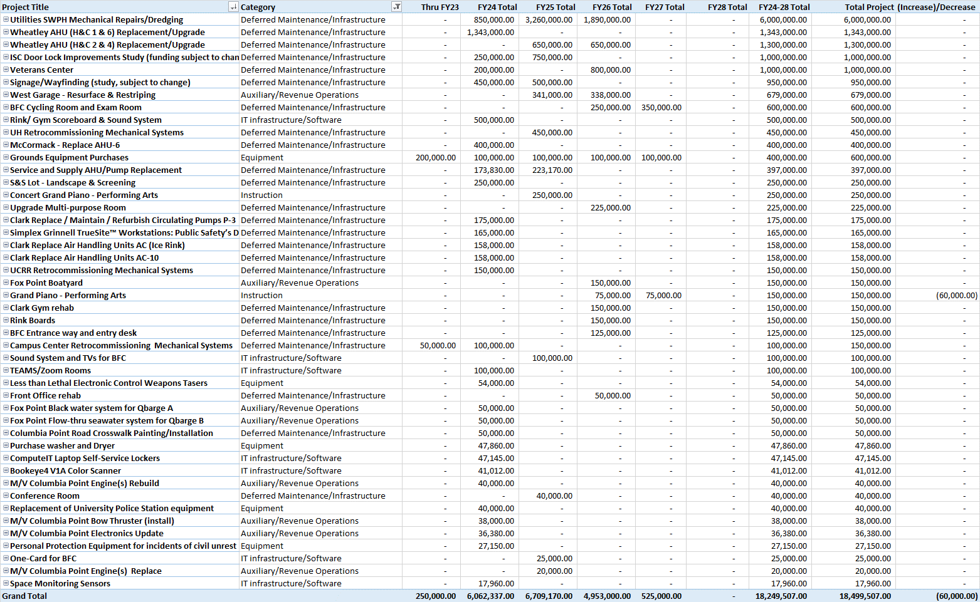
FY24-28 Approved not started local funding

Slide 11
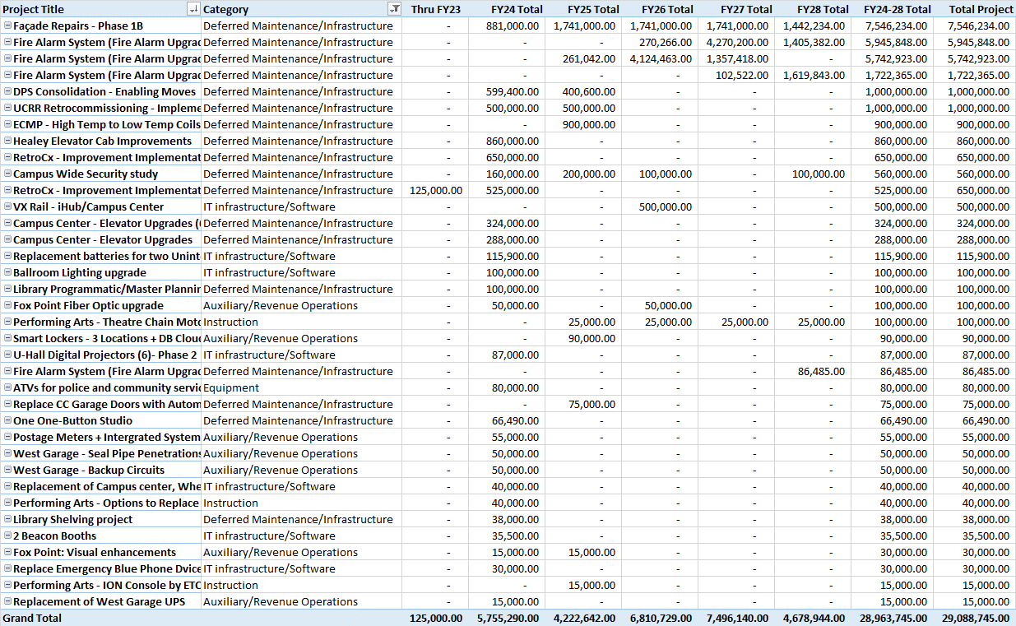
FY24-28 new projects local funding

Slide 12
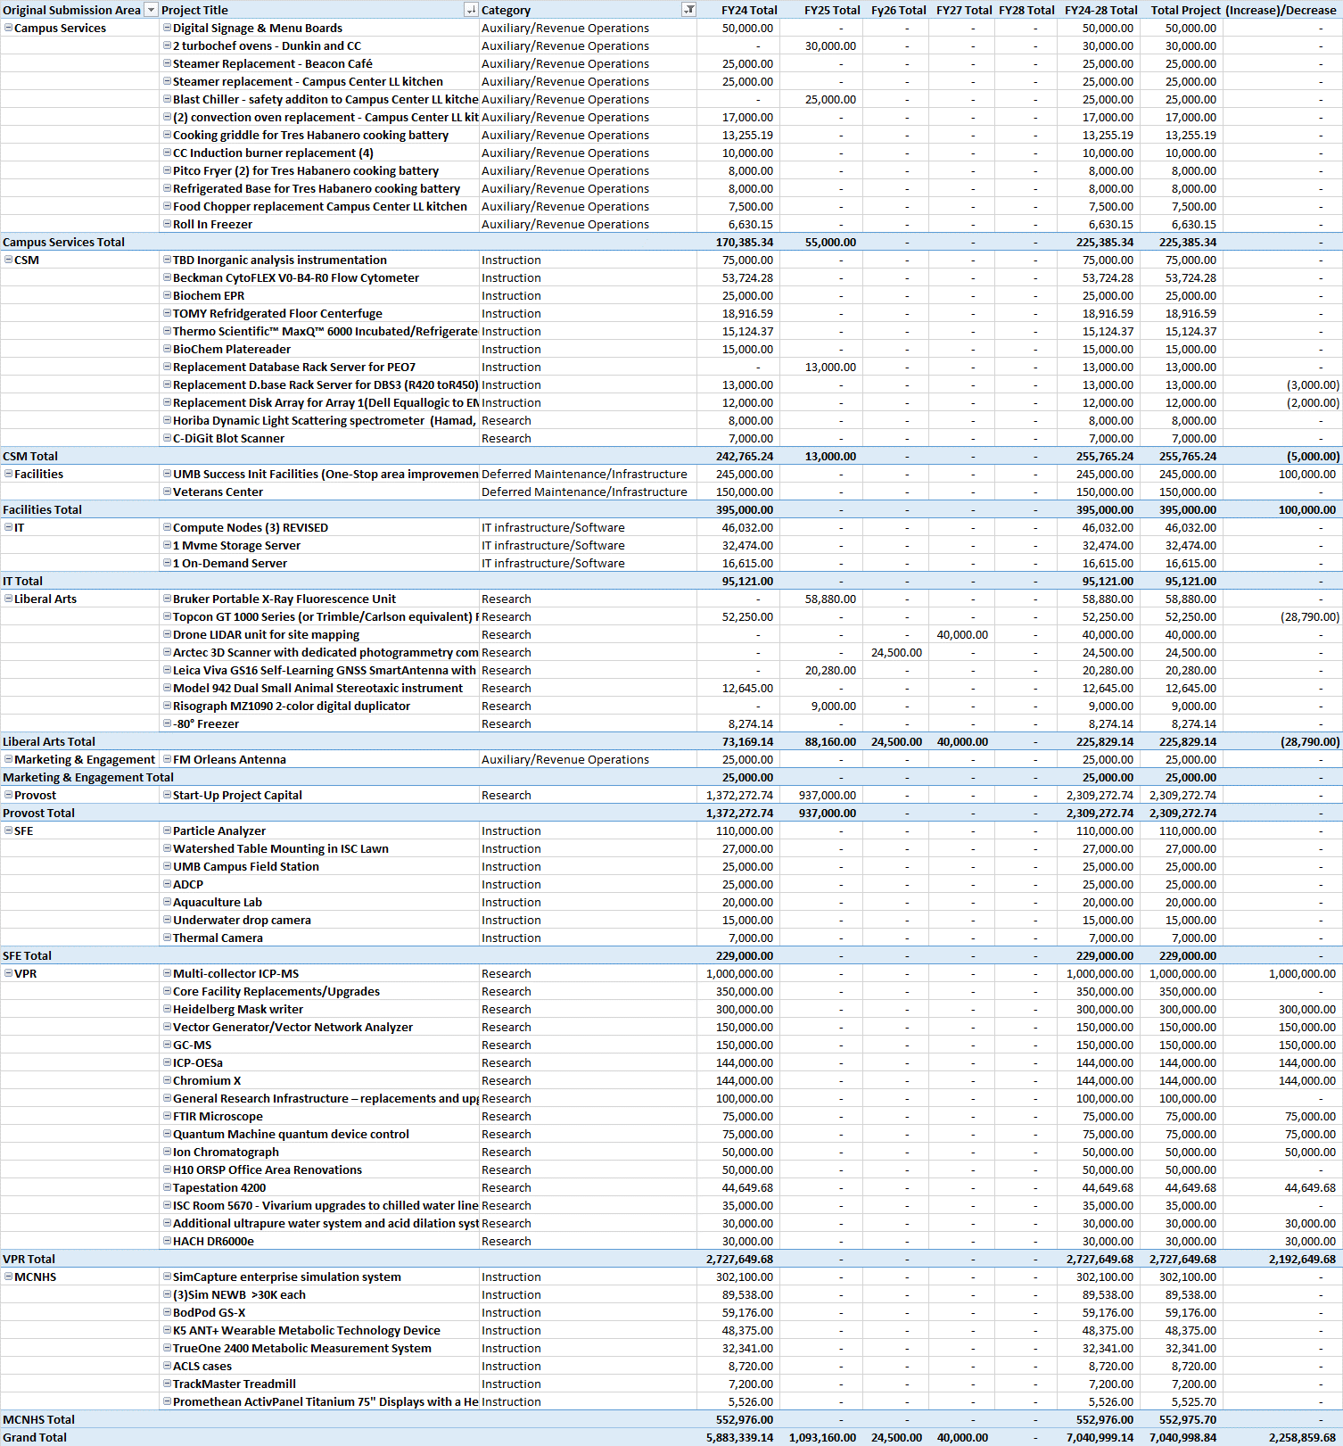
FY24-28 Revenue Based Operations

Slide 13
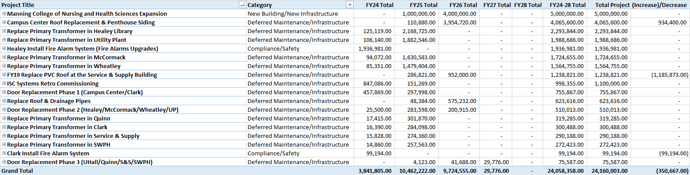
FY24-28 DCAMM Funding

Slide 14
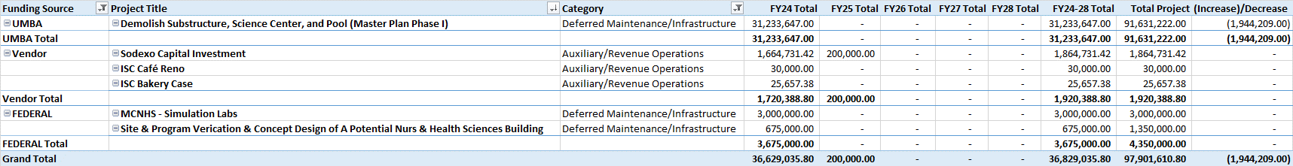
FY24-28 UMBA, Vendor, Federal Funding

